Slide 1

ECE 484 - Advanced Digital Systems Design Lecture 13 – Clock and Synchronization
HQ U.S. Air Force Academy
I n t e g r i t y - S e r v i c e - E x c e l l e n c e
Capt Michael Tanner Room 2F46A 333-6766
Notes:
Write on board:
ECE 315
Day 1 – Admin
Section Marcher
Introductions
Syllabus

Slide 2
Lesson Outline
Clock Distribution Network and Skew
Multiple Clock System
Metastability and Synchronization Failure
Synchronizer
Synthesis Guidelines

Slide 3
Clock Distribution Network and Skew

Slide 4
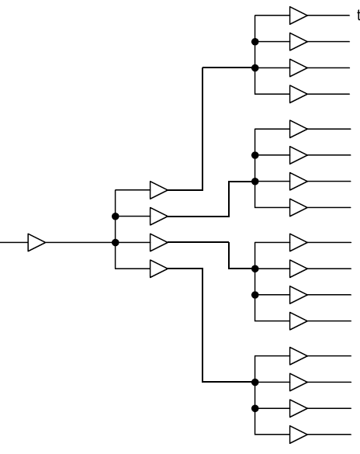
Clock Distribution Network
Ideal clock – clock’s rising edges arrive at FFs at the same time
Real implementation
Driving capability of each cell is limited
Need a network of buffers to drive all FFs b/c of fan out
In ASIC: done by clock synthesis (a step in physical synthesis)
In FPGA: pre-fabricated clock distribution network
Ideal H-Routing
Block Diagram

Slide 5
Clock Skew
Skew – time difference between two arriving clock edges

Slide 6
Timing Analysis
$$T_{c(min)}=T_{cq}+T_{next\left(max\right)}+T_{setup}−T_{skew}$$
Clock skew actually helps increasing clock rate in this particular case

Slide 7

Timing Analysis
If the clock signal travels from the opposite direction:
Now the clock skew decreases the maximum clock rate
Normally we have to consider the worst case since:
No control on clock routing during synthesis
Multiple feedback paths
Hold time constraint
Skew may reduce hold time margin
Hold time violation cannot be corrected in RTL design
$$T_{c(min)}=T_{cq}+T_{next\left(max\right)}+T_{setup}+T_{skew}$$
$$T_{hold}<T_{cq}−T_{skew}$$

Slide 8
Clock Skew Summary
Clock skew normally has negative impact on a synchronous sequential circuit
Effect on setup time constraint – required to increase clock period (i.e., reduce clock frequency)
Effect on hold time constraint – may introduce hold-time violation which can only be fixed during physical synthesis:
re-route clock
re-place register and combinational logic
add artificial delay logic
Skew within 10% of clock period is usually tolerable

Slide 9
Multiple-Clock System

Slide 10
Why Multiple Clocks?
Inherent multiple clock sources (e.g., external communication link)
Circuit size
Clock skew increases with the number of FFs in a system
Current technology can support up to 10,000 FFs
Design complexity – e.g., a system w/16-bit 20MHz processor, 1-bit 100MHz serial interface, 1 MHz I/O controller
Power consideration – dynamic power is proportional to switching frequency

Slide 11
Derived vs. Independent Clocks
Independent clocks – relationship between the clocks is unknown
Derived clocks
A clock is derived from another clock (e.g., different clock rate or phase)
Relationship is known
Logic for the derived clock should be separated from regular logic and manually synthesized (e.g., special delay line or PLL)
A system with derived clock can still be treated and analyzed as a synchronous system
Globally Asynchronous Locally Synchronous System (GALS)
Partition a system into multiple clock domains
Design and verify subsystem in same clock domain as a synchronous system
Design special interface between clock domains

Slide 12
Metastability and Synchronization Failure

Slide 13
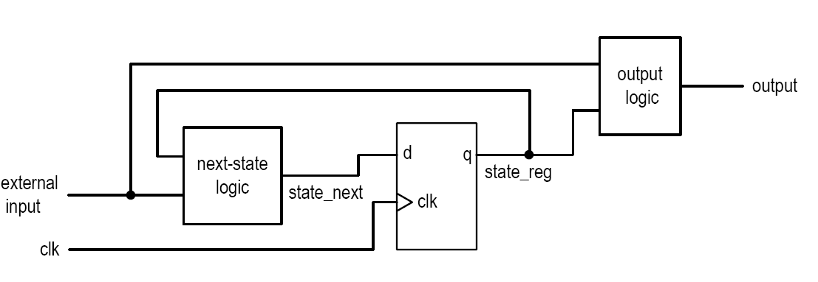
Timing Analysis of a Synchronous System
To satisfy setup time constraint
Signal from the state register
Controlled by the clock
Adjust clock period to avoid setup time violation
Signal from external input
Same if the external input comes from another synchronous subsystem
Otherwise, have to deal with the occurrence of setup time violation

Slide 14
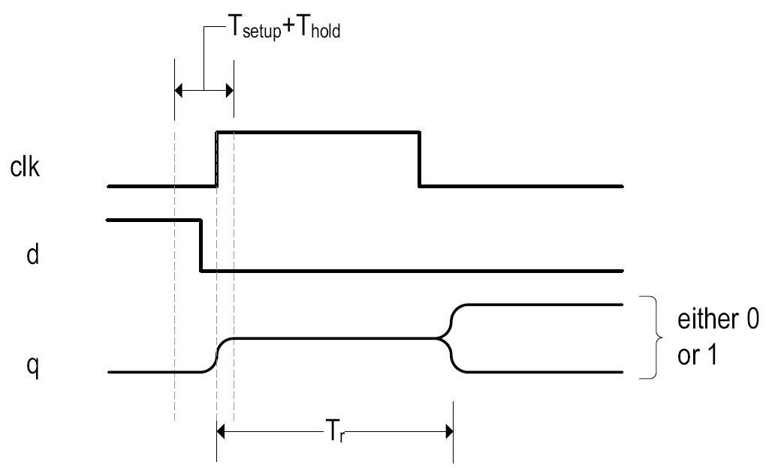
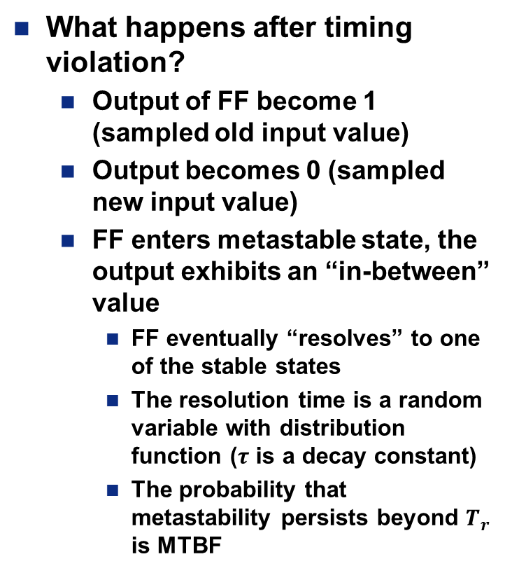
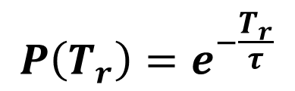
Metastability
What happens after timing violation?
Output of FF become 1 (sampled old input value)
Output becomes 0 (sampled new input value)
FF enters metastable state, the output exhibits an “in-between” value
FF eventually “resolves” to one of the stable states
The resolution time is a random variable with distribution function ($τ$ is a decay constant)
The probability that metastability persists beyond $T_{r}$ is MTBF
$$P\left(T_{r}\right)=e^{−\frac{T_{r}}{τ}}$$

Slide 15
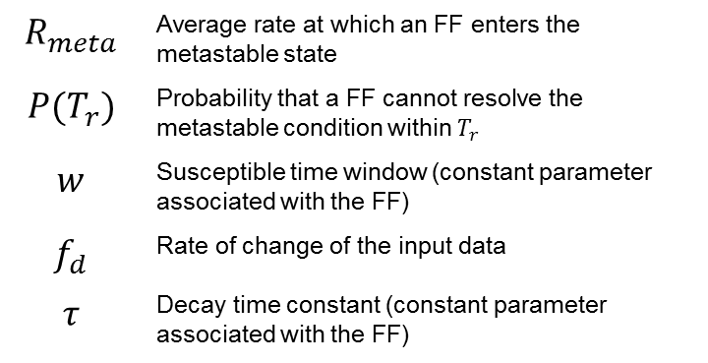
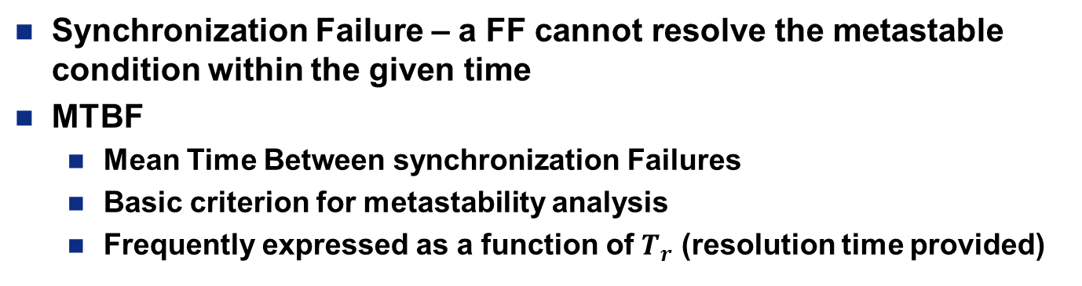
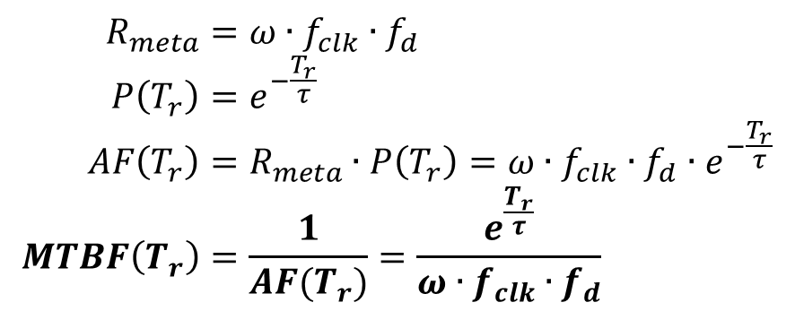
Mean Time Between synchronization Failures (MTBF)
Synchronization Failure – a FF cannot resolve the metastable condition within the given time
MTBF
Mean Time Between synchronization Failures
Basic criterion for metastability analysis
Frequently expressed as a function of $T_{r}$ (resolution time provided)
$$R_{meta}$$ | Average rate at which an FF enters the metastable state
$$P(T_{r})$$ | Probability that a FF cannot resolve the metastable condition within $T_{r}$
$$w$$ | Susceptible time window (constant parameter associated with the FF)
$$f_{d}$$ | Rate of change of the input data
$$τ$$ | Decay time constant (constant parameter associated with the FF)
$$R_{meta}=ω∙f_{clk}∙f_{d} \\ P\left(T_{r}\right)=e^{−\frac{T_{r}}{τ}} \\ AF\left(T_{r}\right)=R_{meta}∙P\left(T_{r}\right)=ω∙f_{clk}∙f_{d}∙e^{−\frac{T_{r}}{τ}} \\ MTBF\left(T_{r}\right)=\frac{1}{AF(T_{r})}=\frac{e^{\frac{T_{r}}{τ}}}{ω∙f_{clk}{∙f}_{d}}$$

Slide 16
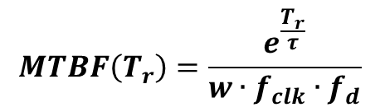
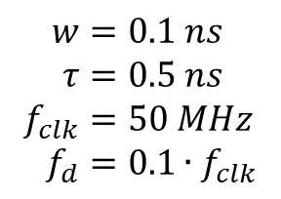
MTBF Example
$$w=0.1 ns \\ τ=0.5 ns \\ f_{clk}=50 MHz \\ f_{d}=0.1∙f_{clk}$$
$$MTBF\left(T_{r}\right)=\frac{e^{\frac{T_{r}}{τ}}}{w∙f_{clk}{∙f}_{d}}$$

Slide 17

MTBF Observations
MTBF is a statistical average
Only $T_{r}$ can be adjusted in a practical design
MTBF is extremely sensitive to $T_{r}$
Good – synchronization failure can easily be avoided by providing additional resolution time
Bad – minor modification can introduce synchronization failure

Slide 18
Synchronizer

Slide 19

Synchronization Circuit
Synchronize an asynchronous input with system clock
No physical circuit can prevent metastability
Synchronizer just provides enough time for the metastable condition to be “resolved”
Example:
$$w=0.1 ns \\ τ=0.5 ns \\ f_{clk}=50 MHz \\ f_{d}=0.1∙f_{clk} \\ T_{setup}=2.5 ns$$

Slide 20
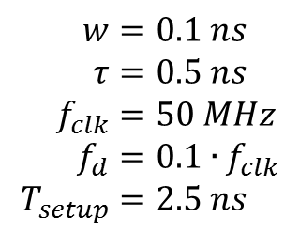
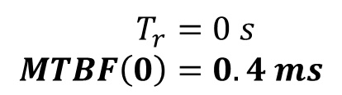
Synchronization Circuit No Synchronizer
$$w=0.1 ns \\ τ=0.5 ns \\ f_{clk}=50 MHz \\ f_{d}=0.1∙f_{clk} \\ T_{setup}=2.5 ns$$
$$T_{r}=0 s \\ MTBF\left(0\right)=0.4 ms$$

Slide 21
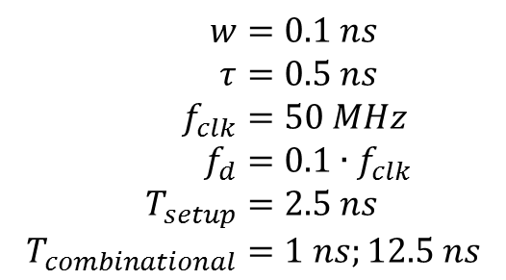
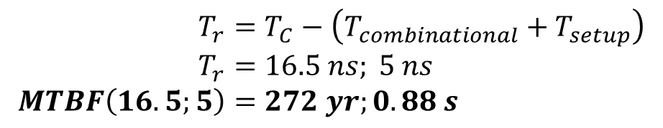
Synchronization Circuit One-FF Synchronizer
$$w=0.1 ns \\ τ=0.5 ns \\ f_{clk}=50 MHz \\ f_{d}=0.1∙f_{clk} \\ T_{setup}=2.5 ns \\ T_{combinational}=1 ns;12.5 ns$$
$$T_{r}=T_{C}−\left(T_{combinational}+T_{setup}\right) \\ T_{r}=16.5 ns; 5 ns \\ MTBF\left(16.5;5\right)=272 yr;0.88 s$$
Not a reliable design

Slide 22
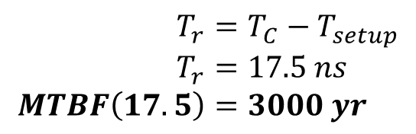
Synchronization Circuit Two-FF Synchronizer
$$w=0.1 ns \\ τ=0.5 ns \\ f_{clk}=50 MHz \\ f_{d}=0.1∙f_{clk} \\ T_{setup}=2.5 ns$$
$$T_{r}=T_{C}−T_{setup} \\ T_{r}=17.5 ns \\ MTBF\left(17.5\right)=3000 yr$$
Most commonly used synchronizer

Slide 23
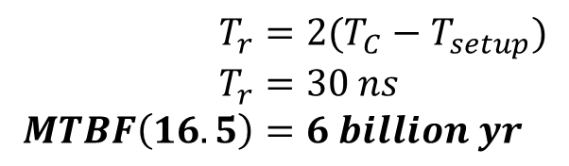
Synchronization Circuit Three-FF Synchronizer
$$w=0.1 ns \\ τ=0.5 ns \\ f_{clk}=50 MHz \\ f_{d}=0.1∙f_{clk} \\ T_{setup}=2.5 ns$$
$$T_{r}=2(T_{C}−T_{setup}) \\ T_{r}=30 ns \\ MTBF\left(16.5\right)=6 billion yr$$
Hardly needed

Slide 24
Why is Synchronization a “Tricky” Issue?
Metastability is basically an “analog” phenomena
Metastability behavior is described by a random variable
Metastability cannot be easily modeled or simulated in gate level (only ‘X’)
Metastability cannot be easily observed or measured in a physical circuit (e.g., MTBF = 3 months)
MTBF is very sensitive to circuit revision (combinational and routing delays)

Slide 25
Synchronization Methods Sharing Data Across Clock Domains
FIFO – synchronization is needed for empty and full status signals
Shared Memory – synchronization needed for arbitration circuit
Dual-Port Memory – meta-stable condition may occur in the internal arbitration circuit

Slide 26
Synthesis Guidelines

Slide 27
Synthesis Guidelines Section 9.5
Asynchronous reset, if used, should be only for system initialization. It should not be used to clear the registers during regular system operation.
Do not manipulate or gate the clock signal. Most desired operations can be achieved by using a register with an enable signal.
LFSR is an effective way to construct a counter. It can be used when the counting patterns are not important.
Throughput and delay are two performance criteria. Adding a pipeline to a combinational circuit can increase the throughput but not reduce the delay.
The main task of adding a pipeline to a combinatioral circuit is to divide the circuit into balanced stages. Software with retiming capability can aid in this task.

Slide 28
Synthesis Guidelines Section 16.11 – Use of a Clock
Do Not manipulate the clock signal in regular RTL design and synthesis.
Minimize the number of clock signals in a system.
Minimize the number of clock domains (i.e., the number of independent clock signals). Use a derived clock signal when possible.
If a derived clock signal is needed, manually derive and instantiate the circuit and separate it from the regular synthesis.

Slide 29
Synthesis Guidelines Section 16.11 – Synchronizer Guidelines
Synchronize a signal in a single place.
Avoid synchronizing related signals.
Use a glitch-free signal for synchronization.
Reanalyze and examine the synchronizer and MTBF when the device is changed or the clock rate is revised.

Slide 30
Synthesis Guidelines Section 16.11 – Interface Between Clock Domains
Clearly identify the boundary of the clock domain and the signals that cross the domain.
Separate the synchronization circuits and asynchronous interface from the synchronous subsystems, and instantiate them as individual modules.
Use a reliable synchronizer design to provide sufficient metastability resolution time.
Analyze the data transfer protocol over a wide range of scenarios, including faster and slower clock frequencies and different data rates.

Slide 31
Lesson Outline
Clock Distribution Network and Skew
Multiple Clock System
Metastability and Synchronization Failure
Synchronizer
Synthesis Guidelines

